Slide 1
SDE Review: GBM & Vasicek
Katherine Anderson

Slide 2
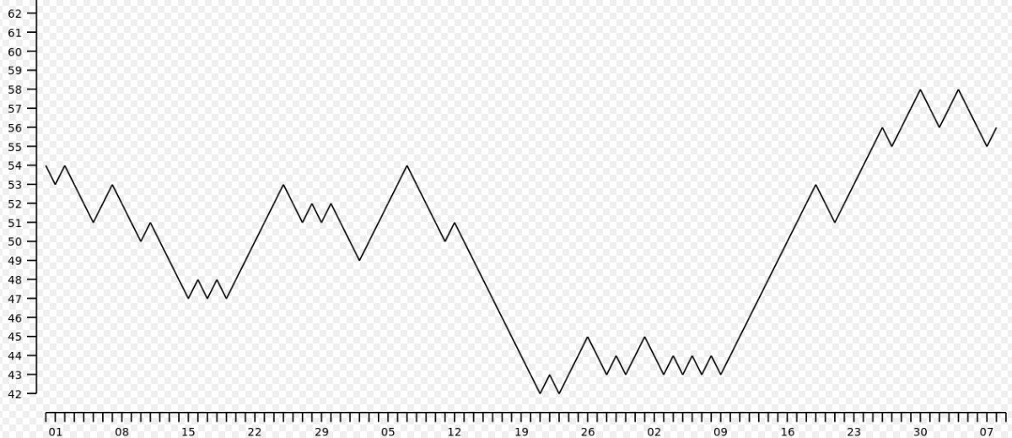
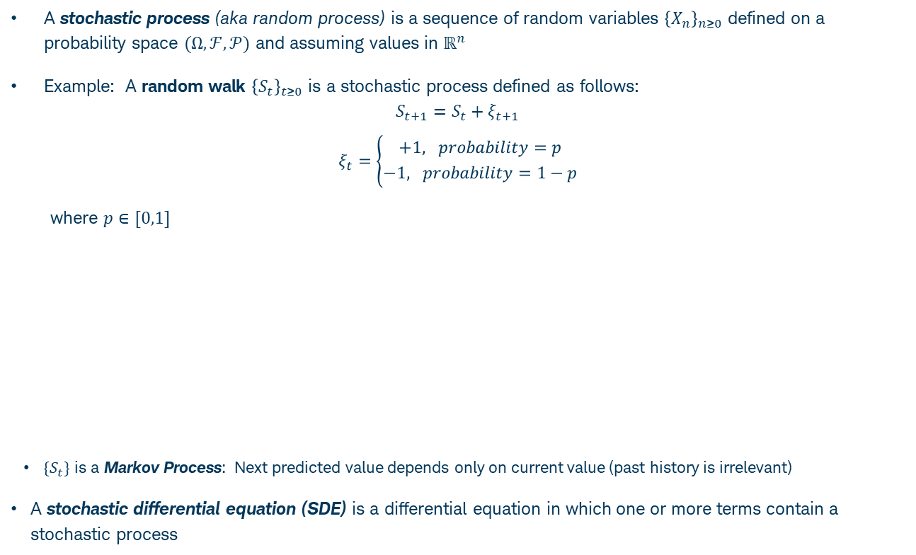
Stochastic Processes & Stochastic Differential Equations (SDEs)
A stochastic process (aka random process) is a sequence of random variables ${\left\{X_{n}\right\}}_{n≥0}$ defined on a probability space $(Ω,ℱ,𝒫)$ and assuming values in $ℝ^{n}$
Example: A random walk ${\left\{S_{t}\right\}}_{t≥0}$ is a stochastic process defined as follows:
$$S_{t+1}=S_{t}+ξ_{t+1}$$
$$ξ_{t}=\left\{{+1, probability=p \atop −1, probability=1−p}\right.$$
where $p∈[0,1]$
$\{S_{t}\}$ is a Markov Process: Next predicted value depends only on current value (past history is irrelevant)
A stochastic differential equation (SDE) is a differential equation in which one or more terms contain a stochastic process

Slide 3
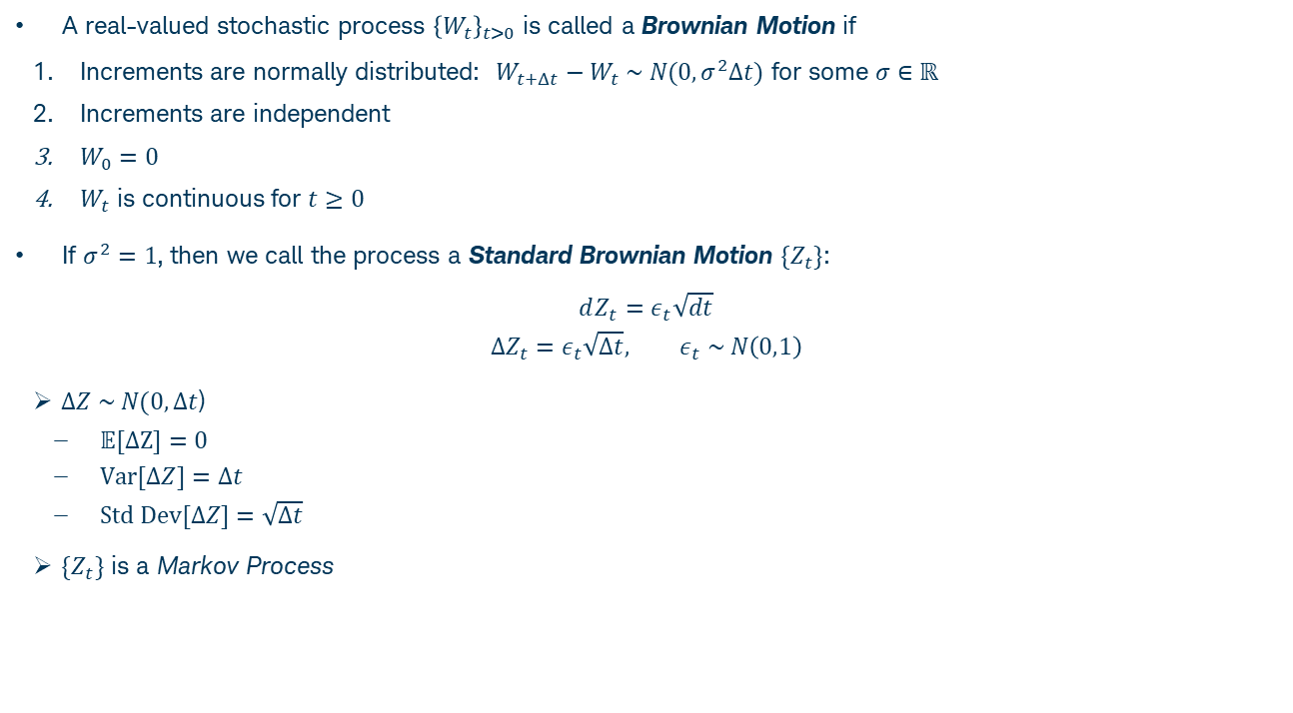
Brownian Motion / Wiener Process
A real-valued stochastic process ${\left\{W_{t}\right\}}_{t>0}$ is called a Brownian Motion if
Increments are normally distributed: $W_{t+Δt}−W_{t} \sim N(0,σ^{2}Δt)$ for some $σ∈ℝ$
Increments are independent
$W_{0}=0$
$W_{t}$ is continuous for $t≥0$
If $σ^{2}=1$, then we call the process a Standard Brownian Motion $\{Z_{t}\}$:
$$dZ_{t}=ε_{t}\sqrt{dt}$$
$$ΔZ_{t}=ε_{t}\sqrt{Δt}, ε_{t} \sim N\left(0,1\right)$$
$ΔZ \sim N(0,Δt$)
$𝔼[ΔZ]=0$
$Var[ΔZ]=Δt$
$Std Dev[ΔZ]=\sqrt{Δt}$
$\{Z_{t}\}$ is a Markov Process

Slide 4
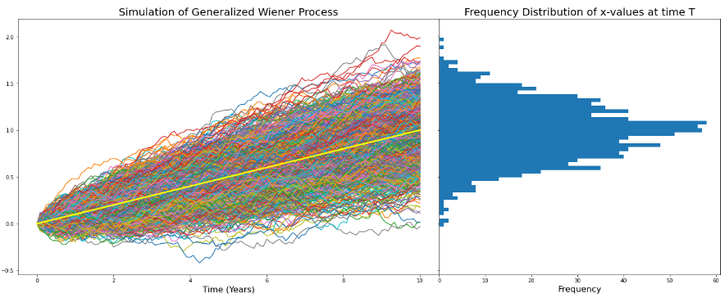

Generalized Wiener Process
Generalized Wiener Process, $X_{t}$:
$$dX_{t}=a dt+b dZ_{t}$$
$a=$ drift rate, $b^{2}=$ variance rate, $Z_{t}=$ standard Brownian motion
If $b=0$, then there is no stochastic component, and we can solve the deterministic function to get $X_{t}=at+X_{0}$ (yellow line in the plot)
d$X_{t} \sim N\left(a dt,b^{2}dt\right); 𝔼\left[dX_{t}\right]=adt, Var\left[dX_{t}\right]=b^{2}dt \overset{⇒}{ } 𝔼\left[X_{T}\right]=aT, Var\left[X_{t}\right]=b^{2}T$
In the simulations below we set $a=0.1, b=0.1, T=10$ years, and use monthly time increments $dt$

Slide 5
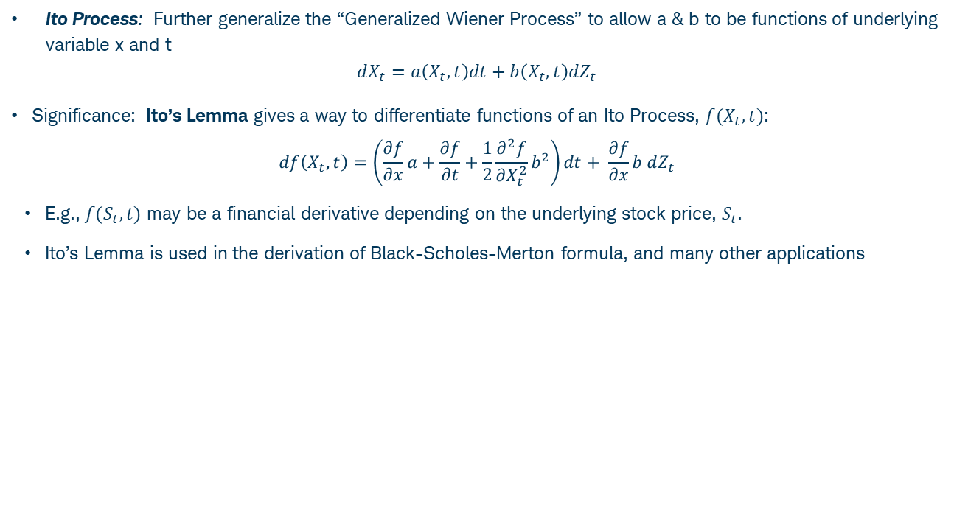
Ito Process
Ito Process: Further generalize the “Generalized Wiener Process” to allow a & b to be functions of underlying variable x and t
$$dX_{t}=a\left(X_{t}, t\right)dt+b\left(X_{t}, t\right)dZ_{t}$$
Significance: Ito’s Lemma gives a way to differentiate functions of an Ito Process, $f(X_{t},t)$:
$$df\left(X_{t},t\right)=\left(\frac{∂f}{∂x}a+\frac{∂f}{∂t}+\frac{1}{2}\frac{∂^{2}f}{∂X_{t}^{2}}b^{2}\right)dt+ \frac{∂f}{∂x}b dZ_{t}$$
E.g., $f(S_{t},t)$ may be a financial derivative depending on the underlying stock price, $S_{t}.$
Ito’s Lemma is used in the derivation of Black-Scholes-Merton formula, and many other applications

Slide 6
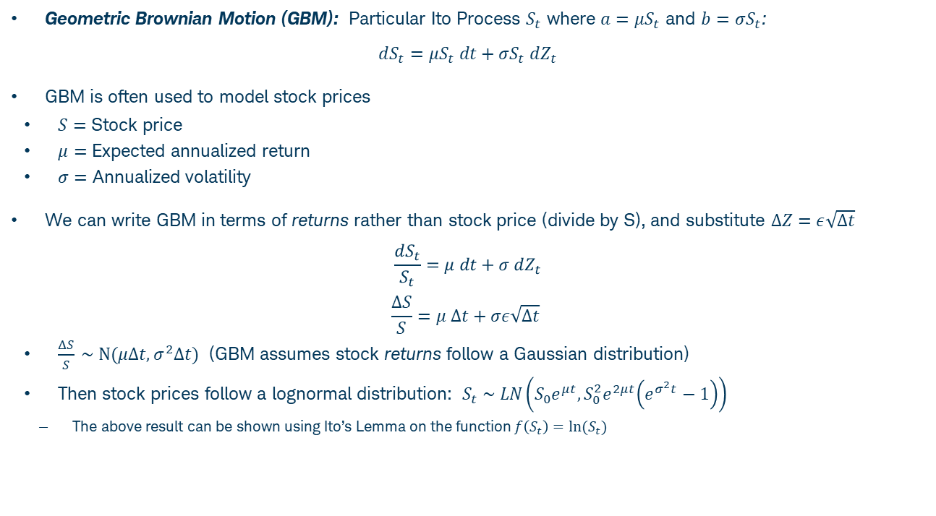
Geometric Brownian Motion
Geometric Brownian Motion (GBM): Particular Ito Process $S_{t}$ where $a=μS_{t}$ and $b=σS_{t}$:
$$dS_{t}=μS_{t} dt+σS_{t} dZ_{t}$$
GBM is often used to model stock prices
$S=$ Stock price
$μ=$ Expected annualized return
$σ=$ Annualized volatility
We can write GBM in terms of returns rather than stock price (divide by S), and substitute $ΔZ=ε\sqrt{Δt}$
$$\frac{dS_{t}}{S_{t}}=μ dt+σ dZ_{t}$$
$$\frac{ΔS}{S}=μ Δt+σε\sqrt{Δt}$$
$\frac{ΔS}{S} \sim N(μΔt,σ^{2}Δt)$ (GBM assumes stock returns follow a Gaussian distribution)
Then stock prices follow a lognormal distribution: $S_{t} \sim LN\left(S_{0}e^{μt}, S_{0}^{2}e^{2μt}\left(e^{σ^{2}t}−1\right)\right)$
The above result can be shown using Ito’s Lemma on the function $f\left(S_{t}\right)=ln⁡(S_{t})$

Slide 7
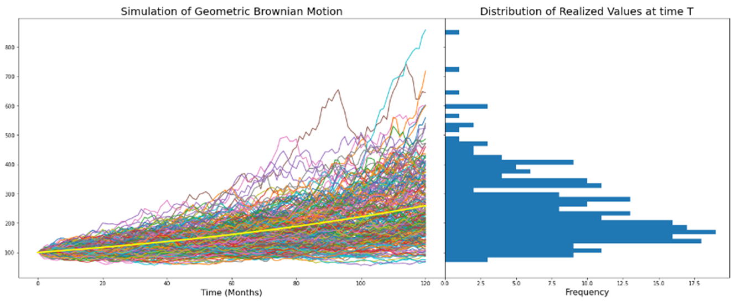

Geometric Brownian Motion
Assume a stock follows GBM with expected annualized return $μ=10\%$ per year and annualized vol $σ=15\%$
Simulate returns for each time step: $r_{i}=\frac{ΔS_{i}}{S_{i−1}}=μ Δt+σε_{i}\sqrt{Δt}$
Solve for price at each time step $S_{i+1 }=S_{0}\prod_{j=1}^{i}{(1+r_{j}) }$
Repeat for large number of paths & plot distribution of terminal prices at time T

Slide 8
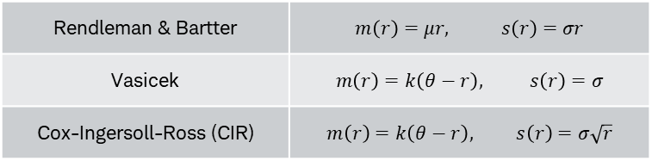
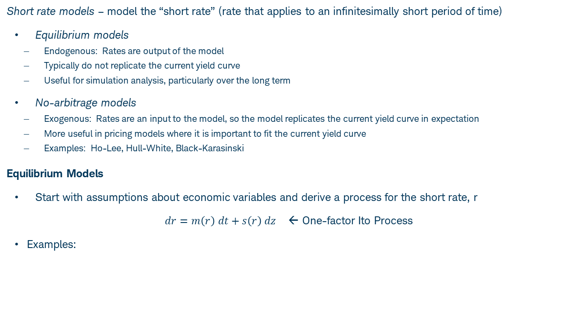
Interest Rate Modeling
Short rate models – model the “short rate” (rate that applies to an infinitesimally short period of time)
Equilibrium models
Endogenous: Rates are output of the model
Typically do not replicate the current yield curve
Useful for simulation analysis, particularly over the long term
No-arbitrage models
Exogenous: Rates are an input to the model, so the model replicates the current yield curve in expectation
More useful in pricing models where it is important to fit the current yield curve
Examples: Ho-Lee, Hull-White, Black-Karasinski
Equilibrium Models
Start with assumptions about economic variables and derive a process for the short rate, r
$dr=m\left(r\right) dt+s\left(r\right) dz$ ← One-factor Ito Process
Examples:

Slide 9
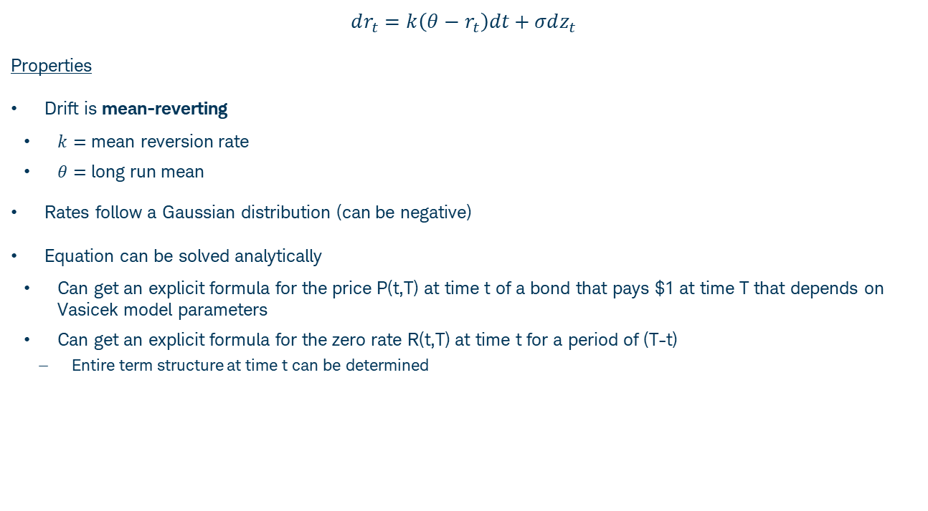
Vasicek Model
$$dr_{t}=k\left(θ−r_{t}\right)dt+σdz_{t}$$
Properties
Drift is mean-reverting
$k=$ mean reversion rate
$θ=$ long run mean
Rates follow a Gaussian distribution (can be negative)
Equation can be solved analytically
Can get an explicit formula for the price P(t,T) at time t of a bond that pays $1 at time T that depends on Vasicek model parameters
Can get an explicit formula for the zero rate R(t,T) at time t for a period of (T-t)
Entire term structure at time t can be determined

Slide 10
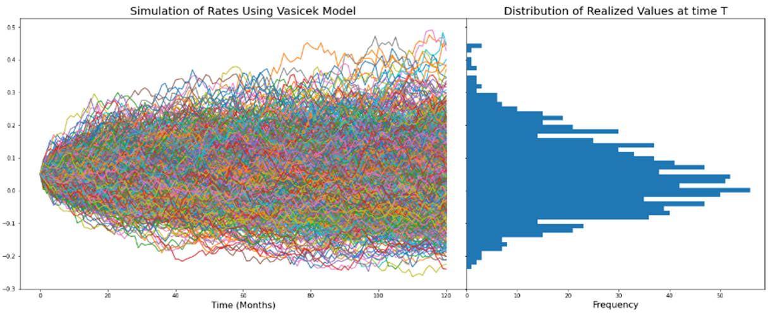

Simulation of Rates Using Vasicek
$$dr_{t}=k\left(θ−r_{t}\right)dt+σdz_{t}$$
$r_{0}=0.05$
$θ=0.03$
$k=0.1$
$σ=.05$
$T=10$ years
$dt=1/12$ (monthly time steps)

Slide 11
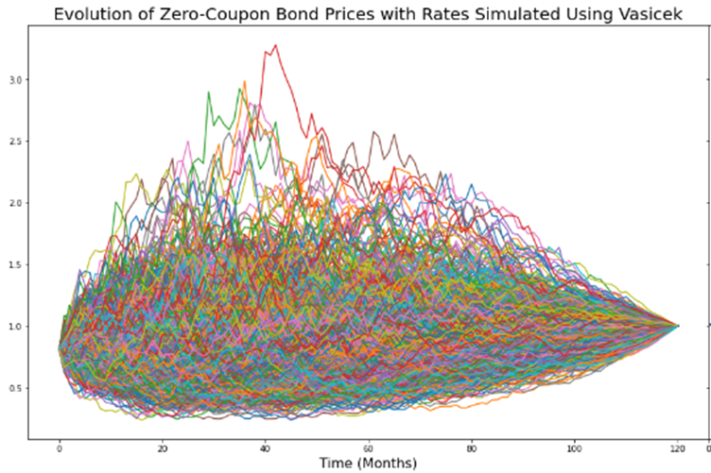

Effect of Rates on Zero-Coupon Bond Prices
The price of a zero-coupon bond $P(t,T)$ can be solved for analytically using the Vasicek model
$$P\left(t,T\right)={A(t,T)e}^{−r\left(t\right)B(t,T)}$$
$$B\left(t,T\right)=\frac{1−e^{−k\left(T−t\right)}}{k}, A\left(t,T\right)=exp⁡\left[\frac{\left(B\left(t,T\right)−T+t\right)\left(k^{2}θ−\frac{σ^{2}}{2}\right)}{k^{2}} − \frac{σ^{2}B{\left(t,T\right)}^{2}}{4k}\right]$$
Using the above formulas and simulated rates on the previous slide, we can calculate bond price at each point in time for each simulation

